Slide 1
EU Energy Platform: Presentation of AggregateEU
Prague
Maciej Ciszewski, deputy Head of Unit, EU Energy Platform
19 April 2023

Slide 2
Agenda
Introduction & update on AggregateEU
Company cooperation
Financial aspects
Contracting and transparency
Questions and discussion

Slide 3
Update on AggregateEU

Slide 4
Update on AggregateEU: Timing
Ongoing
Registrations to PRISMA Platform
Subscriptions to AggregateEU
indicate if buyer/seller. You can subscribe as both but not in one tender
intended location where to sell/buy
indicate financial instruments available to counterparties (if any)
declaration on honour
Call for interest as “Agent on Behalf” and “Central Buyer”
Upcoming
25 April: 1st demand aggregation round
May: 1st tender completed
Feb
Mar
Apr
May
Registration fit for AggregateEU
Subscription to Aggregate EU open
Start demand aggregation
Launch Tender
Matching completed

Slide 5
Process for each tender

Slide 6
Available products
Products
LNG delivery in two areas – North-West and South-East (idem ACER)
Can go to any terminal in the areas
Useful link: What is LNG? : AggregateEU (prisma-capacity.eu)
Delivery on national markets
26 national balancing points (NBPs) are covered
Useful link: What is NBP? : AggregateEU (prisma-capacity.eu)
Minimum quantity
300 GWh (1/3 of a cargo)
5 GWh / month
Duration
For both products, buyers can :
submit demand for a range of maximum 12 consecutive months
submit demand as of M+2 months (e.g. in May for July)
Multiple tendering rounds will be performed

Slide 7
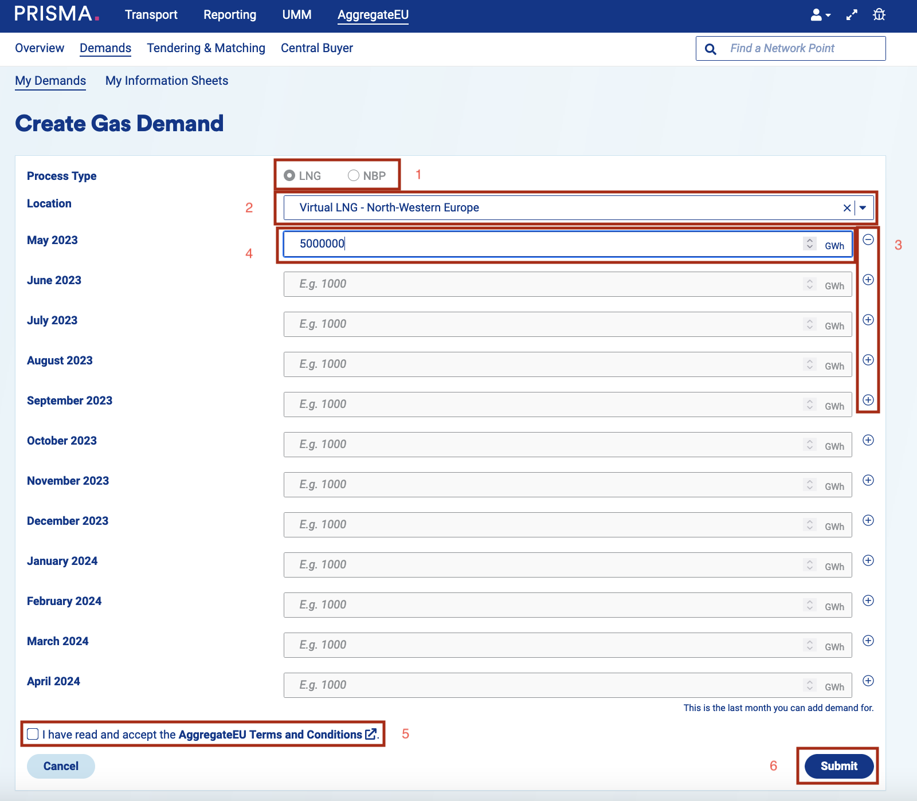
AggregateEU in practice

Slide 8
Models for company cooperation

Slide 9
Company cooperation: key elements
Added value
Facilitate access to AggregateEU for companies below the minimum demand, with limited expertise or credit worthiness.
Principles
Voluntary and temporary
Non-exclusive (other forms of cooperation can be discussed)
Condition
Compliance with competition rules

Slide 10
Company cooperation: two models
Central Buyer
Agent on Behalf
Concept
One company - the Central Buyer - centralises the demand for a group of smaller buyers (buys, negotiates, etc.)
One company - the Agent on Behalf- sells services to buyers (transportation, balancing, etc.)
Demand submitted by
Central Buyer for the group of buyers
Buyers individually (standard process)
Between
Seller and Central Buyer
Central Buyer and each of the smaller buyers
Between
Sellers and buyers
Agent on behalf and buyers
(covering only the relevant services)
Contracts
Other key elements
Competition law requirements
Either a seller or a buyer in one tender
Agent on Behalf does not take title of the gas

Slide 11
Benefiting from Central Buyer or Agent on Behalf services
Central Buyer
Agent on Behalf
No need to register and subscribe, Central Buyer does it for you
You engage in a contract only with the Central Buyer for the gas and for the services you may need
You indicate your demand to the Central Buyer, who procures for you
What to do: find a central buyer and, optionally, contact companies with whom you may want to group demand.
You still need to register on PRISMA and subscribe to AggregateEU
You get direct access to sellers and purchase only the services you need from the Agent on Behalf
What to do: contact an Agent on Behalf

Slide 12
Financial aspects

Slide 13
Financial aspects
Issue
Counterparts will request instruments to mitigate risk of non-payment by buyers or risk of non-delivery by sellers
Role of AggregateEU
Collect information about available financial instruments
Potential support
AggregateEU will list public financial information that may support certain buyers
Useful link: What Are Financial Instruments? : AggregateEU (prisma-capacity.eu)
Next steps
Contact your commercial banks
If relevant, contact one of financial institutions listed on AggregateEU (see details on the website)

Slide 14
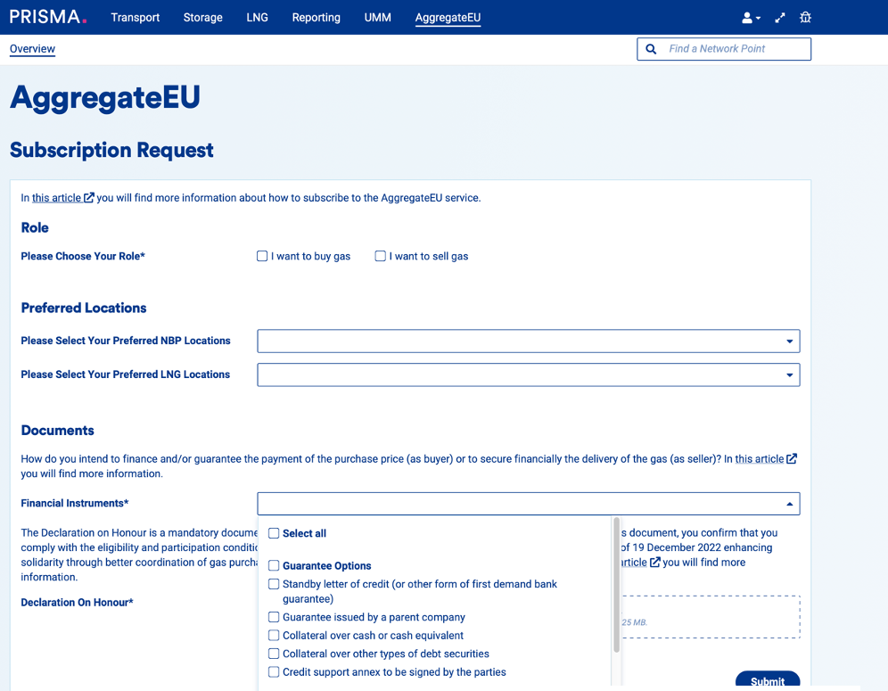
Financial aspects in practice

Slide 15
Example: potential support from EBRD
European Bank for Reconstruction and Development (EBRD) may support certain buyers
Gas supplies must be for one of the EBRD’s countries of operations (list below)
Email to: EU-ENERGY-PLATFORM-FINANCING@ec.europa.eu with
Name and place of incorporation
Ultimate beneficial owner(s)
Destination of the gas
Estimated amount of the requested financial support;
EU Energy Platform will forward your request to the EBRD
How to contact EBRD
EU
Bulgaria
Croatia
Czech Republic
Estonia
Greece
Hungary
Latvia
Lithuania
Poland
Romania
Slovak Republic
Slovenia
Energy Community
Albania
Bosnia and Herzegovina
Georgia
Kosovo
Moldova
Montenegro
North Macedonia
Serbia

Slide 16
Contracting and transparency

Slide 17
Contracting and Transparency
Negotiation between potential Buyer(s) and Seller(s) is done outside AggregateEU Platform
Concluded contracts must be reported by the Buyers to DG ENER via AggregateEU. Contractual parties will have to report:
Counterparties
Gas Quantity
Time Frame
Location
Quality - qualitative assessment of the competitiveness of the contract (optional)
Enter Contract Details
Contract Details
Buyer *
Type to Search
Seller *
Type to Search
Gas Quantity *
E.g. 1000 GWh
Time Frame *
DD.MM:YYYY
DD.MM:YYYY
Location *
Type to Search
Quality
Submit
Illustrative example
AggregateEU will provide this information to DG ENER. Other obligations, such as REMIT obligations, will have to be fulfilled directly by the contractual parties.

Slide 18
Useful links
EU Energy Platform (europa.eu):
https://energy.ec.europa.eu/topics/energy-security/eu-energy-platform_en
AggregateEU – questions and answers (europa.eu):
https://energy.ec.europa.eu/topics/energy-security/eu-energy-platform/aggregateeu-questions-and-answers_en
AggregateEU Hub : PRISMA Capacity Platform (prisma-capacity.eu)
1st step: Registration on Prisma (prisma-capacity.eu):
https://app.prisma-capacity.eu/registration/wizard/start
2nd step: Subscription to AggregateEU (prisma-capacity.eu):
https://app.prisma-capacity.eu/platform/#/start
Additional questions - EU-ENERGY-PLATFORM@ec.europa.eu
Request for financial support - EU-ENERGY-PLATFORM-FINANCING@ec.europa.eu*
(subject to conditions set out on AggregateEU)

Slide 19
Screenshots of AggregateEU

Slide 22
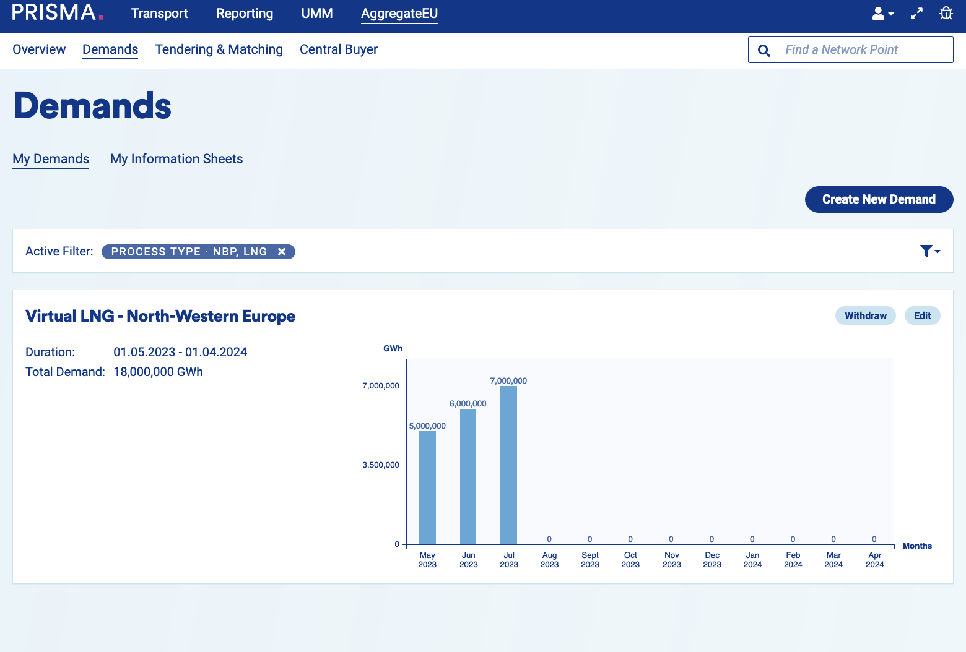

Slide 25
Questions and Answers

Slide 26
Thank you
Maciej Ciszewski – maciej.CISZEWSKI@ec.europa.eu
Notes:
Update/add/delete parts of the copy right notice where appropriate.
More information: https://myintracomm.ec.europa.eu/corp/intellectual-property/Documents/2019_Reuse-guidelines%28CC-BY%29.pdf

